Slide 1
SPPS 255: Principles of Pharmacoepidemiology
Monday, 14 April 2025

Slide 2
Proposed plan
Course Schedule (subject to change)
Week 1 – Introduction to Pharmacoepidemiology / Pharmacoepidemiology study designs
Week 2 – Discussion on readings
Week 3 – Administrative databases (e.g., claims, registries, electronic health records)
Week 4 – Discussion on readings
Week 5 – Bias and Confounding / Methods to address bias and confounding (e.g., propensity score matching)
Week 6 – Discussion on readings
Week 7 –Medication Use Evaluation / Drug Use Evaluation/Drug Use Review
Week 8 – Discussion on readings
Week 9 – Pharmacovigilance / FDA and safety
Week 10 – Bioethical issues and Closing Statement

Slide 3
Administrative databases types
Not meant for research!
Designed for health-related operations (e.g., reimbursement, delivery of healthcare, documentation)
Validation / Reliability depends on the operational purpose(s)

Slide 4
Types of Administrative databases types
Electronic Health Records
Claims / Encounter databases
Registries
Surveillance systems

Slide 5
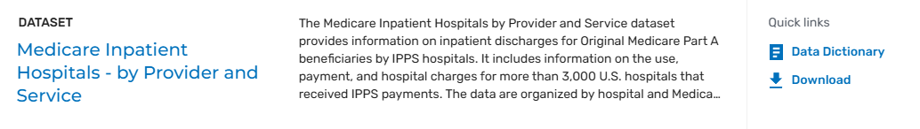
Claims / Encounter databases
Claims data typically include:
ICD 10 diagnosis
Diagnosis Related Group (DRG)
Outpatient encounter codes (HCPSC)
Pharmacy claims
CMS (Data.CMS.gov) → Medicare Provider Analysis and Review (MEDPAR)
Healthcare Common Procedure Coding System (HCPSC) → Current Procedural Terminology (CPT) (link to look up CPT codes)

Slide 6
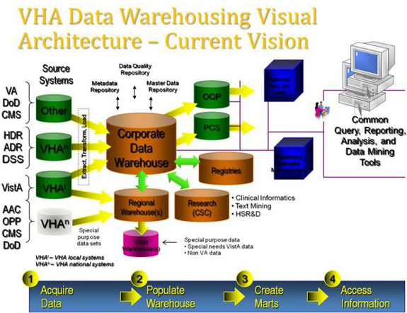
Electronic Health Records
Clinically relevant data for the provision of care for the patient (symptoms, family history, social-economic characteristics)
Includes information on billing, provision of care, non-clinical functions
Laboratory, imaging, diagnostic, and pharmacy (outpatient and inpatient) data
Example: US Department of Veterans Affairs, Kaiser, EPIC
VA Corporate Data Warehouse (CDW)

Slide 7

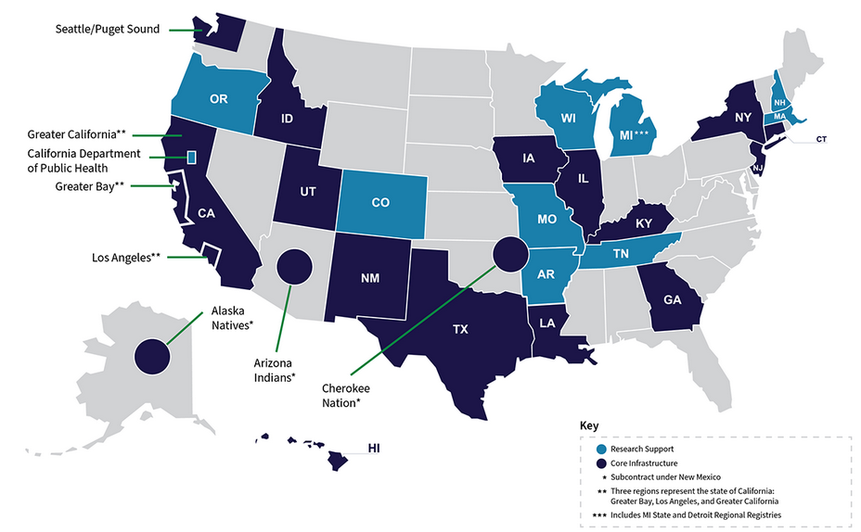
Patient registries
Prospective (on-going) data collection of a specific population
Patient registries can be performed at a single center or part of a population-based, multi-center group
Monitor the longitudinal patterns of treatment, care, expenditures, and outcomes
Provider invaluable information about the specific population’s epidemiologic outcomes
Example: The Surveillance, Epidemiology, and End Results (SEER) Program

Slide 8
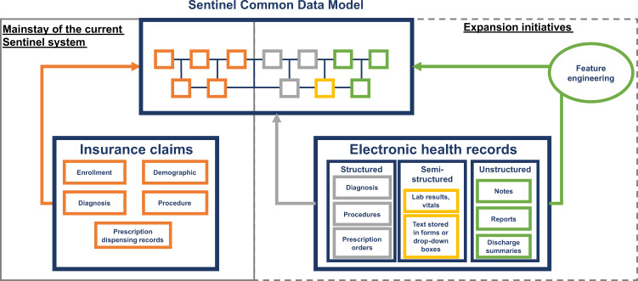
Surveillance
FDA’s Sentinel system (Pilot started in 2008; official launch in 2016)
Monitors adverse events associated with medical products (e.g., drugs)
Uses real-world health insurance claims data from participating systems to construct a longitudinal picture of cause-and-effect relationship between drugs and adverse effects
Desai RJ, Matheny ME, Johnson K, et al. Broadening the reach of the FDA Sentinel system: A roadmap for integrating electronic health record data in a causal analysis framework. NPJ Digit Med. 2021;4(1):170. Published 2021 Dec 20. doi:10.1038/s41746-021-00542-0

Slide 9
Choosing the database
Database | Strengths | Weaknesses | Examples
Claims / Encounter (Insurance database) | Information on patient characteristics, prescription fills, and medical services, as part of the routine administration or reimbursement of healthcare; Large sample size; Valid and accurate for some of the data (e.g., pharmacy claims) | Diagnostic information may not be accurate; Missing clinical details (e.g., laboratory findings, demographics); Heterogeneity across systems | Medicare, Kaiser,* Marketscan, IVQIA
EHR | Patient care database; Clinical information about patients (e.g., laboratory findings, demographics); Large sample size; Valid and accurate; Longitudinal; | Incomplete clinical data; Missing data; Complexity necessitating use of SQL / data architects / Relational Database Management Systems / Corporate Data Warehouse | US Department of Veterans Affairs; Kaiser; EPIC
Patient Registries | Efficient enrollment of specific populations (e.g., disease, geography, system); Large sample size; | Lack of follow-up; Missing data; Maintenance requires substantial effort; Lack of a control population
Surveillance | Large, Accurate and valid; Insurance claims data; Longitudinal; | Requires participation by other healthcare systems; May not be representative of the population; May not be used for hypothesis testing, limited to hypothesis generating; Risk ratio can’t be estimated, need to use disproportionality analysis (e.g., proportional risk ratio) | FDA Sentinel, CDC Vaccine Adverse Event Reporting System (VAERS)
* Kaiser also has an EHR system

Slide 10
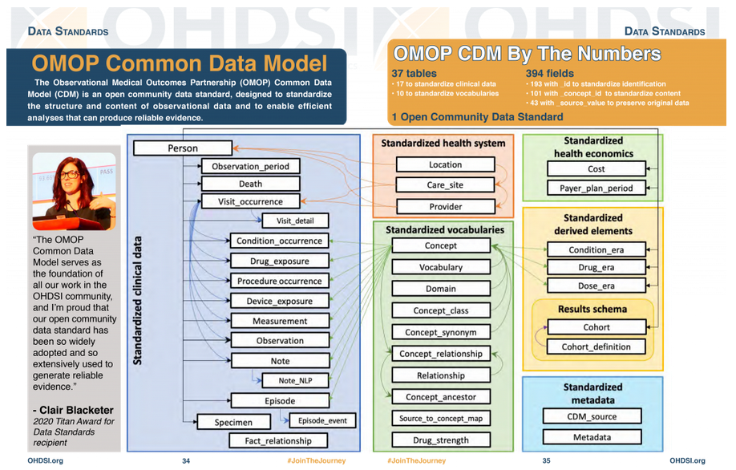
standardization
Challenges with healthcare data include standardizing data elements
Common Data Model
Example: Observational Medical Outcomes Partnership (OMOP)

Slide 11
Other databases
Agency for Healthcare Research and Quality (AHRQ) Medical Expenditure Panel Survey (MEPS)
National Survey of Drug Abuse and Health (NSDUH)
CDC Wide-ranging ONline Data for Epidemiologic Research (WONDER)
NIH data repositories (link)

